Slide 1
Final Battery SoH Prediction Pipeline
1
Battery Dataset
IIT Guwahati
Technical summary
2
Data Preprocessing
cleaned dataset v1
Dataset
IIT Guwahati battery dataset
Input
10 time steps × 2 features
3
Sequence Generation
X (2287, 10, 2)
Target
State of Health (SoH)
Model
TCN (final)
4
Frozen Train / Validation / Test Split
1516 / 379 / 392
Blocks
3 residual (dil. 1, 2, 4)
5
LSTM / GRU / TCN Evaluation
architecture comparison
Filters
32
Dropout
0.2
6
TCN Hyperparameter Selection
validation-based (Day 19)
Learn. rate
5 × 10⁻⁵
Batch size
32
7
Final Frozen TCN
16,929 parameters
Parameters
16,929
8
Held-Out Test Prediction
392 samples (Day 23)
Test set held out
392 samples, first evaluated in final validation (Day 23).
9
SoH Prediction + Error Analysis
MAE · RMSE · sMAPE
Notes:
Sources: Day-22 notebook Cells 3–6 (dataset shapes, split counts 1516/379/392), Day-22 architecture/config cells (filters 32, dropout 0.2, LR 5e-5, batch 32, 16,929 params; 3 residual blocks, kernel 3, dilations 1/2/4). Day-22 cells only build X_test; test predictions are first made in Day-23 Cell 1. LSTM/GRU comparison and Day-19 tuning are not in the supplied notebooks; they are shown as workflow steps only, with no numbers.

Slide 2
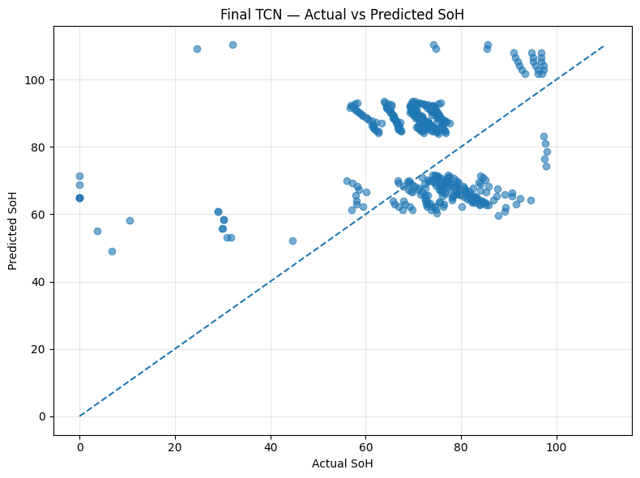
Final Validation & Performance
Test MAE
Test RMSE
Read from the plot (qualitative)
16.96
20.33
Predictions form two bands, off the diagonal
Largest misses at actual SoH ≈ 0–45
Test R² (as in notebook*)
Test sMAPE
0.733
24.95 %
Inference (392 samples)
Per sample
0.386 s
≈ 0.99 ms
*R² as printed in Day-23 notebook; Cell 1 applies abs() to it.
Model size (float32 est.)
Parameters
≈ 66.1 KB
16,929
Actual vs predicted SoH — test set (Day 23)
Metric | Final TCN (test)
MAE | 16.96
RMSE | 20.33
R²* | 0.733
Parameters | 16,929
Inference time | 0.386 s / 392 samples
Compact (16,929 params, ≈ 66 KB) and fast (≈ 1 ms/sample); accuracy claim pending baseline comparison.
Notes:
Sources: Day-23 Cell 1 (MAE 16.956742, RMSE 20.334396, sMAPE 24.9507 %, 0.386211 s total, 0.00098523 s/sample, 1014.99 samples/s), Cell 2 (66.13 KB = params x 4 bytes, an estimate, not a saved file size; total incl. optimizer state is 50,789), Cell 4 (actual vs predicted plot, extracted unchanged). IMPORTANT: Day-23 Cell 1 computes test_r2 = abs(r2_score(...)); the printed 0.733207 is therefore |R²| and is deliberately NOT shown. Recompute with r2_score(y_test, y_test_pred) and insert the signed value. Inference timing is a single predict() call on 392 samples in Colab with no warm-up; hardware not recorded. Baseline values are not in the supplied notebooks.

Slide 3
Final Technical Review — Conclusions & Action Items
A
Key conclusions
B
Remaining technical questions
C
Mentor corrections / actions
Method: TCN selected via validation-based tuning (Day 19)
Frozen split: 1516 / 379 / 392 stored in the dataset file
Held-out test (n = 392): MAE 16.96 · RMSE 20.33 · sMAPE 24.95 %
Complexity: 16,929 params (≈ 66 KB); ≈ 1 ms/sample in one run
Low-SoH / near-EOL: plot shows large misses at actual SoH ≈ 0–45
Test R²: notebook value uses abs(); confirm signed value
Day-19 vs Day-22: val MAE 14.34 → 16.88, best epoch ≈ 28 → 10; why?
Per-cell robustness: battery_id available, breakdown not yet run
Complexity vs baseline: baseline results pending
Before real-world use: what further validation is required?
Validate final test metrics
Confirm error-analysis requirements
Review low-SoH performance
Confirm baseline comparison
Confirm pipeline reproducibility
Record mentor feedback
Accuracy claim withheld: baseline comparison is still pending.
Apply corrections before submission
Notes:
Sources: Day-22 Cell 5 (split counts), Day-22 final training log (early stopping at epoch 18, restored best epoch 10, best val loss 522.475) and validation check (MAE 16.875757, RMSE 22.857713, R² 0.106387) vs the Day-19 reference values supplied in the brief (MAE 14.343437, RMSE 21.880802, R² 0.181139, best epoch ≈ 28). Test numbers from Day-23 Cell 1. Day-19 tuning and the LSTM/GRU comparison are not in the supplied notebooks. No saved model file/checkpoint appears in either notebook; the Day-23 notebook re-trains the TCN in-session, which is relevant to the reproducibility question.

